Slide 1



















Tahaluf Copyright 2022- All Right Reserved
Harmony IT Solution
learning Hub
Angular
Tahaluf Training Center 2022

Slide 2









Tahaluf Copyright 2022- All Right Reserved
Harmony IT Solution
1
Toastr Library.
2
Linking with API.
3
Hits API (Get All).
4
5
6
7
8
8
9

Slide 3










Tahaluf Copyright 2022- All Right Reserved
Harmony IT Solution
Objective

Slide 4
Tahaluf Copyright 2022- All Right Reserved
Harmony IT Solution
The Objective of this lecture
Install the toaster service and understand how to show the toaster in your project.
Get to know about the HTTP client protocol and how it is important with the liking with API.
Link the angular project with the API project and solved the CROS police error.

Slide 5
Tahaluf Copyright 2022- All Right Reserved
Harmony IT Solution
Toastr Library

Slide 6
Tahaluf Copyright 2022- All Right Reserved
Harmony IT Solution
Overview of Toastr Library
Toastr is a JavaScript library that creates pop-up notifications.
It is simple, easy to use, and can be extended.
It allows you to create simple toasts using HTML5 and JavaScript.
حفظ الترجمة

Slide 7
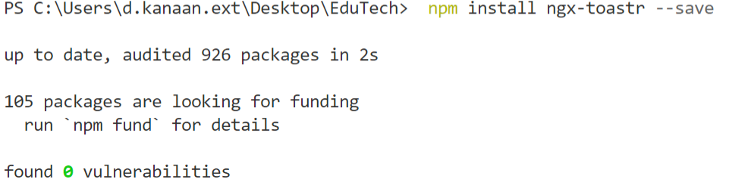
Tahaluf Copyright 2022- All Right Reserved
Harmony IT Solution
Steps to download the Toastr Library in the project
حة
Step One: Install the toastr package using this command:
npm install ngx-toastr --save

Slide 8
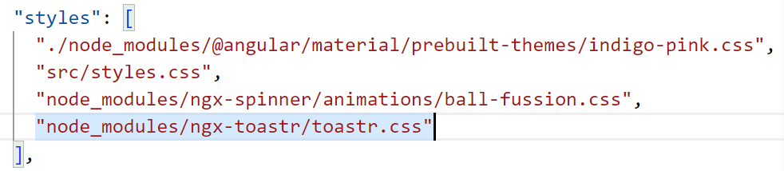
Tahaluf Copyright 2022- All Right Reserved
Harmony IT Solution
Steps to download the Toastr Library in the project
حة
Step Two: Add the style of the toastr in the angular.json file.

Slide 9
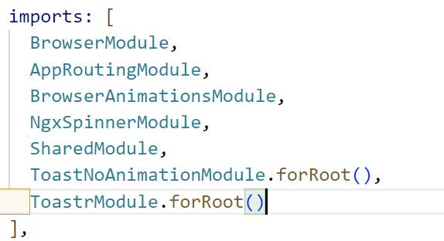
Tahaluf Copyright 2022- All Right Reserved
Harmony IT Solution
Steps to download the Toastr Library in the project
Step Three: Import the ToasterModule and ToastrNoAnimationModule in the root module(app.module.ts).
import {ToastrModule, ToastNoAnimation,
ToastNoAnimationModule}
from 'ngx-toastr'
Note: Don’t forget to add the module’s name in the import array.

Slide 10

Tahaluf Copyright 2022- All Right Reserved
Harmony IT Solution
Toastr Library Example
To add the toastr in the home component
Import the ToastrService in the typescript of the component.
So, In home.component.ts.
import {ToastrService} from 'ngx-toastr';

Slide 11
Tahaluf Copyright 2022- All Right Reserved
Harmony IT Solution
Toastr Library Example
Create an instance of toastr service in the constructor of the component
and then use this object to access the toastr method like success, warning, error, and info.

Slide 12
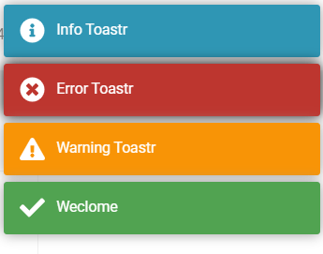
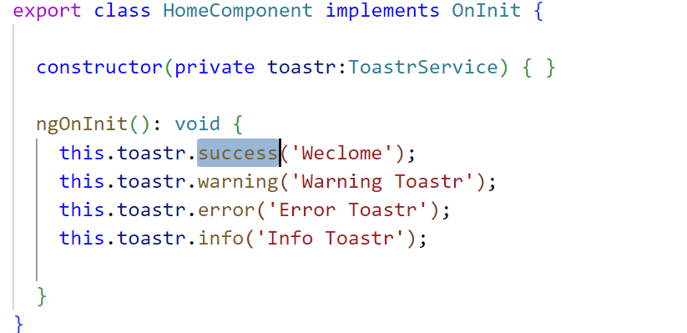
Tahaluf Copyright 2022- All Right Reserved
Harmony IT Solution
Toastr Library Example

Slide 13
Tahaluf Copyright 2022- All Right Reserved
Harmony IT Solution
Linking with API

Slide 14
Tahaluf Copyright 2022- All Right Reserved
Harmony IT Solution
Overview of Linking with API
To access various back-end services and download data, most front-end applications communicate with a server via the HTTP protocol.
There is an HTTP API provided by Angular, the HttpClient class in @angular/common/http.

Slide 15
Tahaluf Copyright 2022- All Right Reserved
Harmony IT Solution
Overview of the HTTPClient
The HTTPClient service is an injectable service that provides powerful methods for communicating with the remote server.
HttpClient API makes it easy to perform an HTTP POST, GET, PUT, and DELETE requests.

Slide 16
Tahaluf Copyright 2022- All Right Reserved
Harmony IT Solution
Overview of HTTPClient
Angular provides a built-in package called HTTP.
To use this package, first, you must add the module for this package to the shared module for our project.
import{HttpClientModule}from '@angular/common/http'
And add HttpClientModule in the import and export section.
Notes:
import{HttpClientModule}from '@angular/common/http'

Slide 17
Tahaluf Copyright 2022- All Right Reserved
Harmony IT Solution
Cross-Origin Resource Sharing (CORS)
Is a protocol that manages communication between two or more domains.
Is a method based on HTTP headers that allow browsers to identify requests coming from an allowed domain list while also filtering out those requests coming from unknown sources.

Slide 18
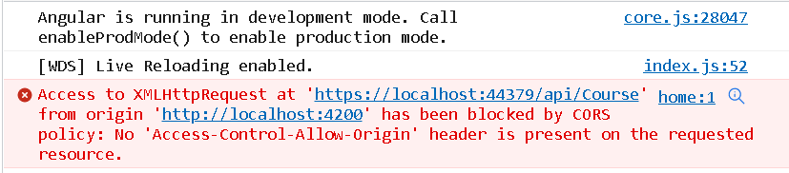
Tahaluf Copyright 2022- All Right Reserved
Harmony IT Solution
Cross-Origin Resource Sharing (CORS)
This error will be in the console of the browser.

Slide 19
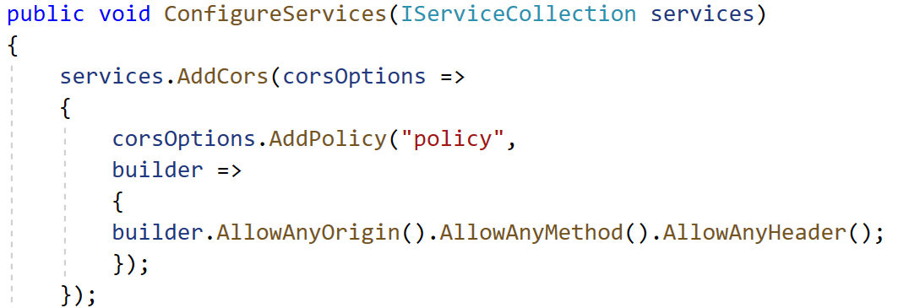
Tahaluf Copyright 2022- All Right Reserved
Harmony IT Solution
Cross-Origin Resource Sharing (CORS)
To fixe this error add the following lines of code to your API project.
In the Startup.cs file → at the beginning of ConfigureServices method.
Notes:
services.AddCors(corsOptions =>
{
corsOptions.AddPolicy("policy",
builder =>
{
builder.AllowAnyOrigin().AllowAnyMethod().AllowAnyHeader();
});
});

Slide 20
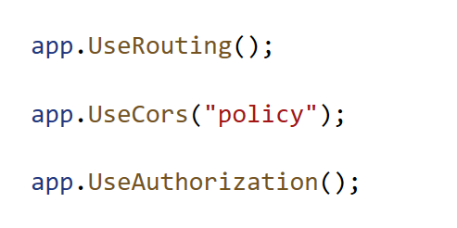
Tahaluf Copyright 2022- All Right Reserved
Harmony IT Solution
Cross-Origin Resource Sharing (CORS)
Then in the Startup.cs file → Configure method add this line of code:
app.UseCors(“policy");
Notes:
app.UseCors("policy");

Slide 21
Tahaluf Copyright 2022- All Right Reserved
Harmony IT Solution
Hits API (Get All)

Slide 22
Tahaluf Copyright 2022- All Right Reserved
Harmony IT Solution
How to retrieve data from a table using HttpClient Service
حة
Step one: Create an object of httpClient service in the constructor.
Step two: Use this object to access the HTTP methods like (get, post, put, delete).
Step three: The data will be retrieved as a JSON object, so we need to declare an array to store this data.

Slide 23
Tahaluf Copyright 2022- All Right Reserved
Harmony IT Solution
Example using HttpClient methods
Retrieve the data from the course table and display this data in the course component.
Step one: In the home service create an object of httpClient service
Notes:
constructor(private http:HttpClient, private spinner :NgxSpinnerService,private toastr:ToastrService) { }

Slide 24
Tahaluf Copyright 2022- All Right Reserved
Harmony IT Solution
Example using HttpClient methods
Step two: Declare an array to store the data that will be retrieved.
In-home service.ts
course:any=[{}];
Notes:
course:any=[{}];

Slide 25
Tahaluf Copyright 2022- All Right Reserved
Harmony IT Solution
Example using HttpClient methods
Step three: use the HTTP method (get) to receive the data from the course table and save it in the data array that is declared in the previous step.

Slide 26
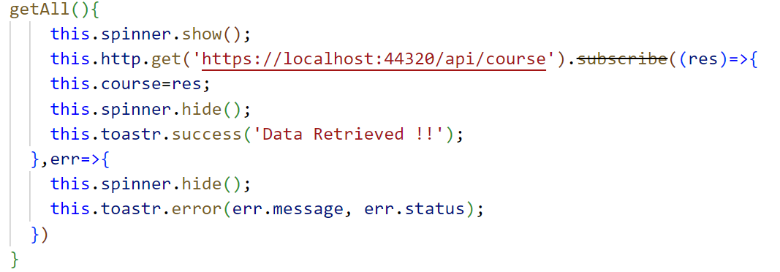
Tahaluf Copyright 2022- All Right Reserved
Harmony IT Solution
Example using HttpClient methods
Notes:
getAll(){
this.spinner.show();
this.http.get('https://localhost:44320/api/course').subscribe((res)=>{
this.data=res;
this.spinner.hide();
this.toastr.success('Data Retrieved !!');
},err=>{
this.spinner.hide();
this.toastr.error(err.message, err.status);
})
}

Slide 27
Tahaluf Copyright 2022- All Right Reserved
Harmony IT Solution
Example using HttpClient methods
Step four: Create an object of home Service in the course component.
In Course component.ts
Notes:
constructor(private router:Router, public home:HomeService) { }

Slide 28
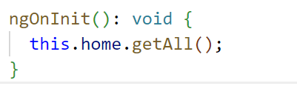
Tahaluf Copyright 2022- All Right Reserved
Harmony IT Solution
Example using HttpClient methods
Step five: Call the get all method from the home service in the ngOnInit method.
In Course component.ts
Notes:
ngOnInit(): void {
this.home.getAll();
}

Slide 29
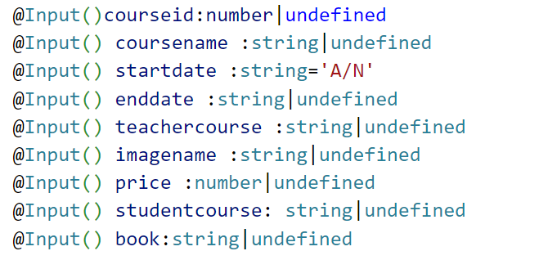
Tahaluf Copyright 2022- All Right Reserved
Harmony IT Solution
Example using HttpClient methods
Step six: Update the input decorators properties to be the same name as the columns in the database and in the same datatype.
In Course-Card component.ts
Notes:
@Input()courseid:number|undefined
@Input() coursename :string|undefined
@Input() startdate :string='A/N'
@Input() enddate :string|undefined
@Input() teachercourse :string|undefined
@Input() imagename :string|undefined
@Input() price :number|undefined
@Input() studentcourse: string|undefined
@Input() book:string|undefined

Slide 30
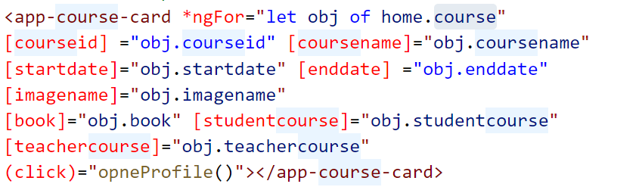
Tahaluf Copyright 2022- All Right Reserved
Harmony IT Solution
Example using HttpClient methods
Step seven: Update the HTML file for the Course component.
Notes:
constructor(private router:Router, public home:HomeService) { }

Slide 31

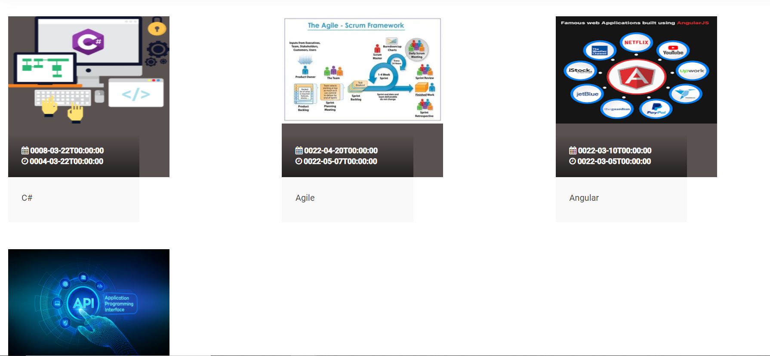
Tahaluf Copyright 2022- All Right Reserved
Harmony IT Solution
Example using HttpClient methods
If the data is retrieved successfully the result will be :
Notes:
constructor(private router:Router, public home:HomeService) { }

Slide 32
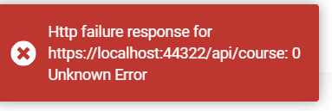
Tahaluf Copyright 2022- All Right Reserved
Harmony IT Solution
Example using HttpClient methods
If the data is not retrieved, a toaster error will appear.
Notes:
constructor(private router:Router, public home:HomeService) { }

Slide 33
Tahaluf Copyright 2022- All Right Reserved
Harmony IT Solution
References
[1] Angular, “Angular,” Angular.io, 2019. https://angular.io/
[2] “Complete Angular Tutorial For Beginners,” TekTutorialsHub. https://www.tektutorialshub.com/angular-tutorial/
[3]“npm | build amazing things,” Npmjs.com, 2019. https://www.npmjs.com/
[4]“Angular Tutorial for Beginners | Simplilearn,” Simplilearn.com. https://www.simplilearn.com/tutorials/angular-tutorial (accessed Aug. 19, 2022).
Overview of Database

Slide 34
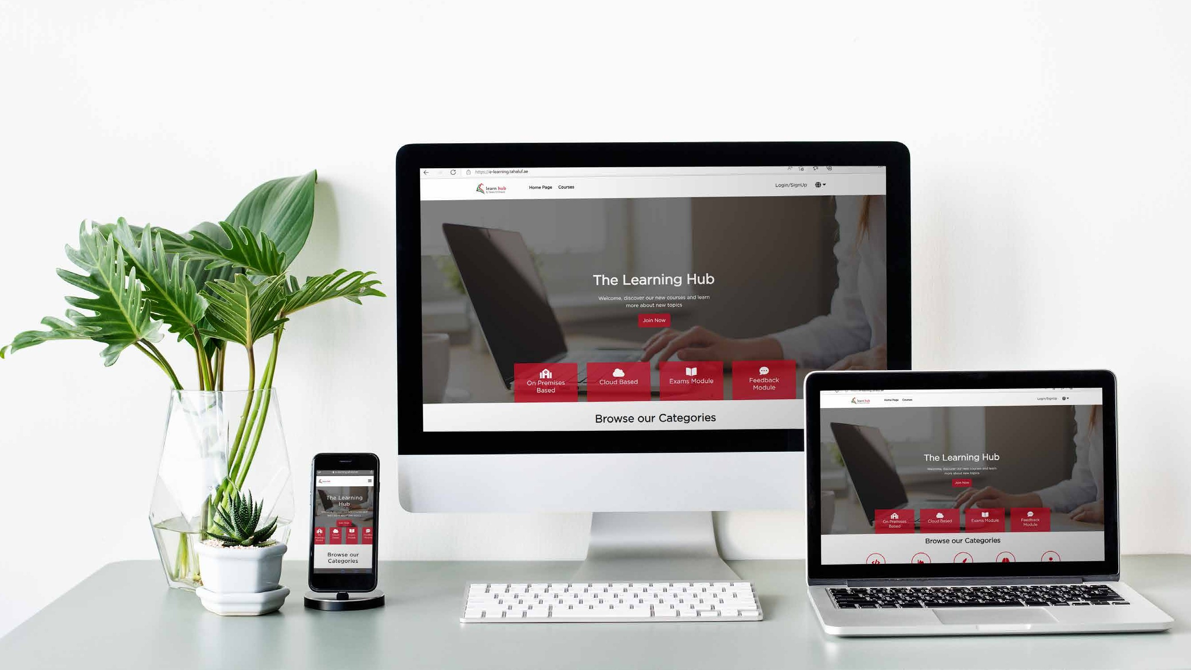







Tahaluf Copyright 2022- All Right Reserved
Harmony IT Solution
Thank youﻂﺤﻧ
Any Question?

